Slide 1

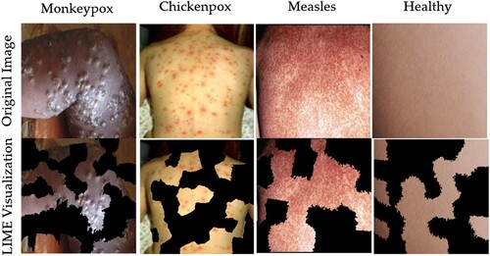
GURU NANAK DEV ENGINEERING COLLEGE BIDAR INFORMATION SCIENCE AND ENGINEERING MONKEYPOX DISEASE DETECTION AND PREDECTION
Presented by
BHAGYAVANTI (3GN21IS008)
BHOOMIKA (3GN21IS009)
PREMALA (3GN21IS029)
RAKSHITA (3GN21IS032)
Under the guidance of
PROF. SHRUTI PATIL

Slide 2

Contents
Introduction
Literature Survey
Problem statement
Objectives
System Analysis
System Specifications
System Design
Screenshots
Conclusion
References

Slide 3
Introduction
Monkeypox is a viral disease caused by the monkeypox virus, a member of the Orthopoxvirus genus.
It was first identified in laboratory monkeys in 1958 and later in humans in 1970 in Central and West African regions. Monkeypox presents symptoms similar to smallpox but generally with milder severity.
These include fever, lymphadenopathy, muscle aches, and a characteristic rash that progresses to pustules. The growing global concern regarding monkeypox stems from its potential to cause localized outbreaks, primarily through human-to-human transmission or contact with infected animals.
The need for effective and timely detection is critical to controlling the spread of this disease and preventing outbreaks.

Slide 4
Continues
With advancements in technology, artificial intelligence (AI) and machine learning (ML) have emerged as powerful tools in the healthcare domain.
Machine learning algorithms, especially those based on deep learning, have demonstrated high efficiency in processing and analyzing complex data, including medical images.
This study leverages these capabilities to develop an automated system for detecting monkeypox and similar skin conditions from medical images, ensuring early diagnosis and appropriate interventions.

Slide 5
Problem statement
Monkeypox poses a significant public health challenge due to its increasing prevalence and potential for outbreaks.
Traditional diagnostic methods rely heavily on clinical expertise and laboratory tests, which are time-intensive, costly, and inaccessible in resource-limited settings. Misdiagnosis or delayed detection exacerbates the spread of the disease and hinders timely medical intervention.
The visual similarities of monkeypox to other skin conditions, such as chickenpox and measles, further complicate accurate diagnosis. Additionally, the lack of automated tools for early detection limits the ability to respond effectively to emerging cases. This underscores the urgent need for a reliable, efficient, and accessible diagnostic solution.

Slide 6
Objectives
The primary objective of this study is to develop an automated system for detecting monkeypox using deep learning techniques, providing an accurate and efficient diagnostic tool.
Leveraging the VGG19 algorithm, a pre-trained convolutional neural network model, the project aims to classify skin images into categories, including monkeypox, chickenpox, measles, and normal conditions.
The dataset for training and testing the model is sourced from Kaggle, containing diverse and labeled skin images to ensure robust performance and reliability. Additionally, the project integrates a Flask web application to offer a user-friendly interface for image uploads and real-time predictions.
This solution is designed to enhance early detection accuracy, reduce diagnostic time, and facilitate accessible healthcare support in combating monkeypox outbreaks.

Slide 7
Literature survey
Sl No | Name of Author | Title of Paper | Methods | Results | Remarks with Respect to the Project
1 | X. Zhang, Y. Li, and Z. Wang | A Traditional Image Processing Method for Disease Detection | Applied traditional image processing techniques like thresholding, edge detection, and feature extraction to classify skin diseases, including monkeypox. | The method achieved moderate accuracy but struggled with complex skin conditions and noisy images, leading to higher false positives and negatives. | Traditional methods based on manual feature extraction are limited in accuracy and adaptability. The deep learning-based approach using CNN (VGG19) offers superior accuracy by automatically learning relevant features, improving performance, and handling complex images more effectively.

Slide 8
Continues
Sl No | Name of Author | Title of Paper | Methods | Results | Remarks with Respect to the Project
2 | D. Kumar, R. Gupta | Rule-Based System for Skin Disease Classification | Used a rule-based system to classify skin diseases based on predefined symptom patterns and image features. | The rule-based system worked in controlled scenarios but failed to generalize well across varied skin conditions, particularly for diseases with similar symptoms. | Rule-based systems are limited by predefined rules and lack flexibility. The deep learning model offers better generalization, capable of distinguishing between similar conditions like monkeypox and measles, making it more robust and accurate.

Slide 9
Methodology
1)Dataset Collection and Preprocessing:
A labeled dataset for skin conditions, including monkeypox, chickenpox, measles, and normal skin images, was sourced from Kaggle. The images were resized to 224x224 pixels to ensure compatibility with the input requirements of the VGG19 model. Data augmentation techniques, such as rotation, zoom, and horizontal flipping, were applied to enhance model robustness and mitigate overfitting.
2) Model Selection and Training:
The VGG19 architecture, pre-trained on the ImageNet dataset, was utilized for feature extraction. The top layers of the model were replaced with a custom fully connected layer and a softmax activation layer to classify four categories. The model was fine-tuned with a categorical cross-entropy loss function and an Adam optimizer for optimal performance. The training process included validation to monitor performance and avoid overfitting.

Slide 10
Continues
3)Flask Web Application Development:
A Flask-based web application was created to provide a user-friendly interface for image uploads and result visualization. The application processes uploaded images, passes them through the trained model, and displays predictions along with the probability scores.
4)Integration of Cause and Treatment Information:
The system maps predictions to a predefined dictionary containing the causes and recommended treatments for each condition. This feature provides actionable insights to the user, bridging the gap between detection and informed decision-making.

Slide 11
Continues
5)Evaluation and Testing:
The model's performance was evaluated using metrics such as accuracy, precision, recall, and F1-score. Confusion matrices were plotted to analyze classification performance across categories. The system was tested with unseen images to validate its generalizability and reliability.
6)Deployment and Use Case Testing:
The trained model and web application were deployed to a production environment. Real-world testing scenarios ensured the application’s readiness for practical use.
7)Email Notification System:
To enhance responsiveness, an email notification feature was integrated into the application. When the model detects monkeypox in an uploaded image, automated emails are sent to predefined addresses, alerting users or medical professionals to take immediate action.

Slide 12
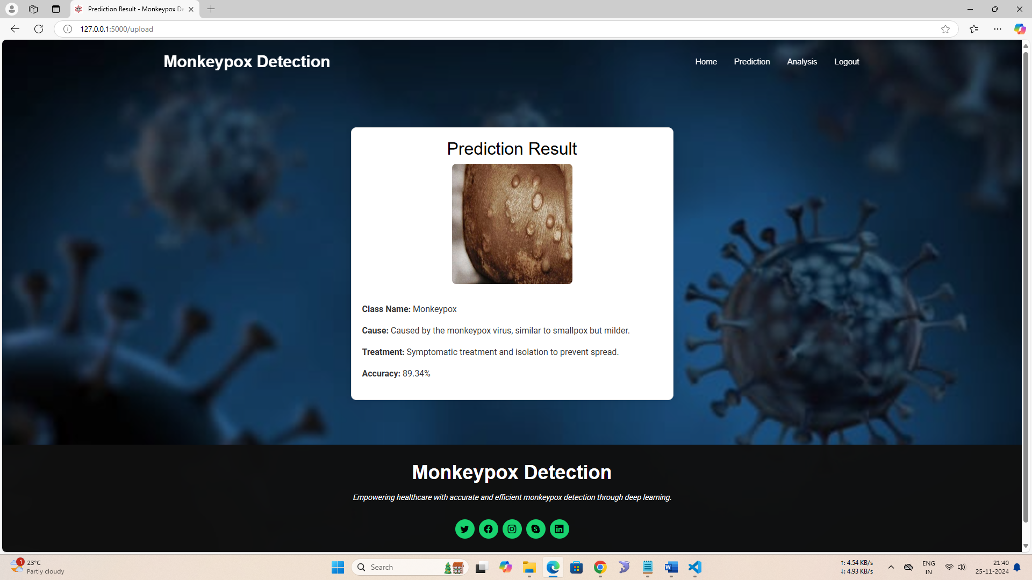
Results & Discussion
Figure : Predicted Result as Monkeypox with cause, treatment and accuracy

Slide 13
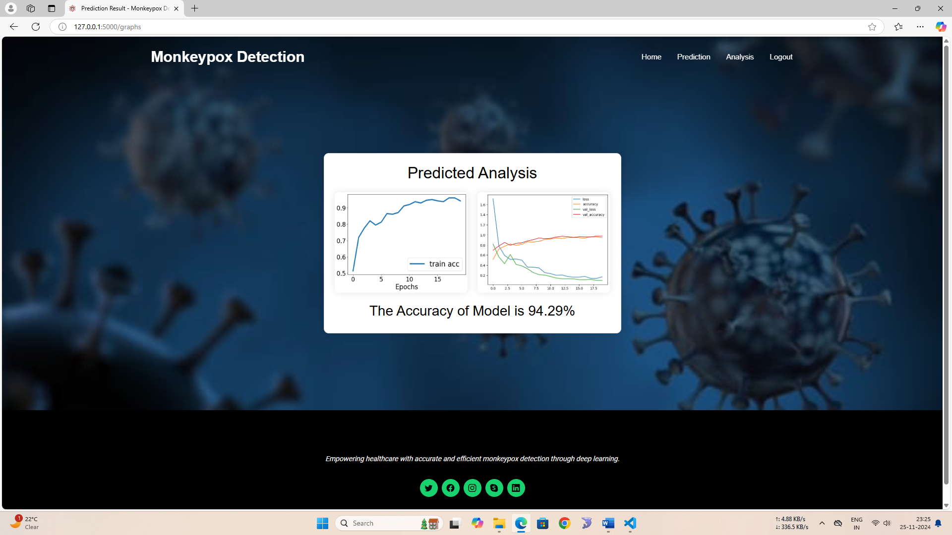
Results
Fig : Predicted Analysis Graph

Slide 14

Conclusion
The project successfully developed an automated system for detecting monkeypox and similar skin conditions using deep learning techniques.
By leveraging the VGG19 convolutional neural network (CNN), pre-trained on the ImageNet dataset and fine-tuned for this task, the system efficiently classifies images into categories such as monkeypox, chickenpox, measles, and normal skin conditions.
Advanced image preprocessing, data augmentation, and transfer learning were employed to ensure high accuracy and generalizability. The system was integrated into a user-friendly web application built with Flask, allowing healthcare providers and users to upload images for real-time predictions.
The results showed that the system performs reliably, accurately identifying monkeypox and differentiating it from other skin conditions.

Slide 15
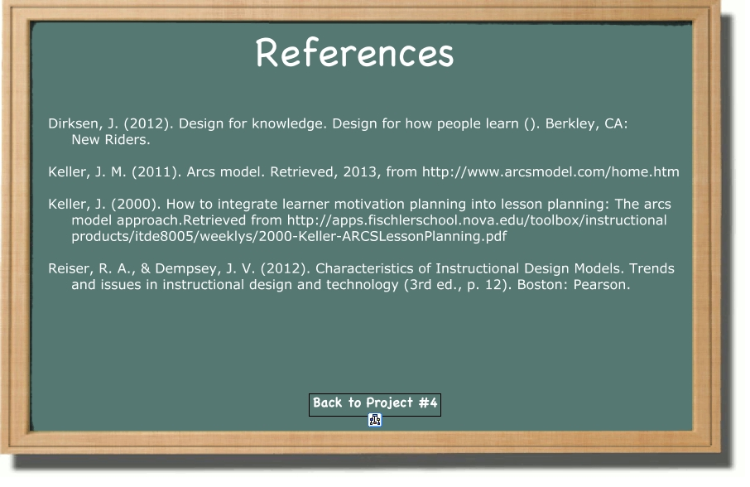
References
[1]Monkeypox Outbreaks and AI Solutions for Early Detection by John D. Smith, Clara Lee, and Michael Brown, 2023.
[2] Deep Learning for Viral Disease Detection: A Comprehensive Study by Aisha Khan and Robert Taylor, 2021.
[3]Automated Diagnosis of Skin Lesions Using CNNs by Priya Sharma and Ankit Patel, 2020.
[4] AI in Public Health: Combatting Monkeypox with Technology by Elena Garcia and Mark Robinson, 2022.
[5]Transfer Learning for Rare Disease Detection by Wei Liu and David Kim, 2019.

Slide 16
Continues
[6]Advances in Skin Lesion Classification Using AI by Emily Watson and James Carter, 2020.
[7]AI-Driven Early Detection of Monkeypox by Sara Wilson and Henry Adams, 2023.
[8]Deep Learning Applications in Infectious Disease Management by Neha Kapoor and Rahul Gupta, 2018.
[9] Skin Disease Detection Using AI: A Case Study on Monkeypox by Ali Hassan and Maria Chen, 2021.
[10]Monkeypox Lesion Classification Using Neural Networks by Jacob Turner and Fiona Hall, 2022.

Slide 17
Thank You

